Slide 1

Women's Safety Smart Band:Empowering Security
A compact wearable ensuring instant safety & confidence

Slide 2
Introduction: A New Era of Personal Safety
In an evolving world, personal safety remains a paramount concern, particularly for women. Traditional solutions often fall short, being either inconvenient, conspicuous, or ineffective in real-time crisis situations. We recognize the urgent need for a discreet, user-friendly, and highly effective personal protection device.
1
2
3
Rising Safety Concerns
Need for Compact Protection
Our Innovative Solution
An increasing global awareness of safety vulnerabilities facing women in various environments.
Introducing a wearable smart band designed to offer immediate and discreet security.
A demand for personal safety tools that are non-intrusive, always accessible, and simple to use.

Slide 3

The Problem: A Gap in Personal Security
The current landscape of personal safety often leaves individuals vulnerable during critical moments. Existing solutions can be cumbersome, unreliable, or provide delayed assistance, failing to address the immediate and evolving nature of threats.
Harassment & Threats: Pervasive safety risks in both public and private spaces.
Dangerous Delays: Critical time lost in emergency contact, exacerbating dangerous situations.
Lack of Accessible Tools: A significant void in instant, user-friendly self-defense mechanisms.
"Safety is not a luxury, it's a fundamental right. We aim to make it an accessible reality for everyone."

Slide 4




Our Mission: Redefining Personal Safety
We are committed to empowering individuals with cutting-edge technology that integrates seamlessly into daily life, providing unparalleled security and peace of mind.
Immediate Emergency Access
Real-time Location Sharing
One-touch direct dialing to 911 for rapid response.
Live GPS tracking shared instantly with pre-selected contacts.
Safe Deterrence
Accessible Design
Integrated buzzer, strobe light, and vibration for non-lethal self-defense.
Lightweight, stylish, and affordable for broad accessibility.

Slide 5
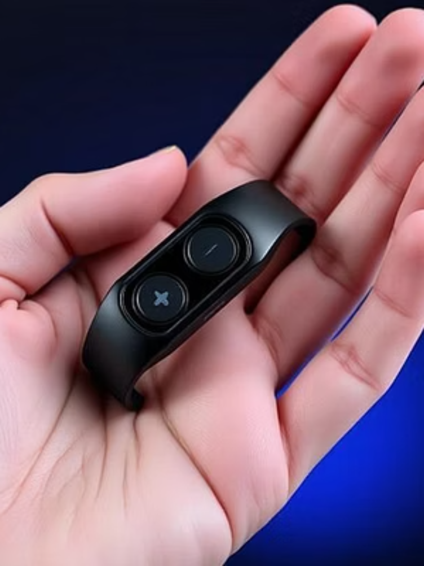
Introducing the Sentinel Smart Band
The Sentinel Smart Band is engineered for simplicity and effectiveness. Its intuitive two-button design ensures that critical safety features are just a press away, disguised within a sleek, modern aesthetic.
Button 1 (SOS)
Initiates an immediate call to 911 and sends your live location to pre-set emergency contacts, ensuring rapid assistance.
Button 2 (Deterrent)
Activates a powerful auditory buzzer, a disorienting strobe light, and a discreet vibration motor to deter threats effectively.
Discreet Design: Designed to resemble a contemporary fitness tracker, the Sentinel Smart Band blends seamlessly into daily wear, offering protection without drawing unwanted attention.

Slide 6
How It Works: Seamless Integration of Safety
The Sentinel Smart Band operates on a robust, multi-layered system designed for instantaneous action, ensuring reliability when it matters most.
01
02
03
User Activation
Microcontroller Activation
Communication Protocols
A simple press of either the SOS or Deterrent button by the user initiates the safety sequence.
The embedded microcontroller instantly processes the input and activates the relevant safety functions.
The GSM module places an emergency call to 911 and dispatches SMS alerts to designated contacts.
04
05
Location Pinpointing
Active Deterrence
The GPS module accurately pinpoints and shares the user's live location for precise tracking.
Integrated actuators trigger the high-decibel buzzer, pulsating LED strobe, and vibration motor for immediate threat deterrence.

Slide 7
Technical Components: The Core of Sentinel Safety
Our Smart Band is built with high-quality, reliable components to ensure maximum performance and durability.
Microcontroller
Brain of the device
ESP32 / Arduino Nano for efficient processing
GSM Module
Emergency Communication
SIM800L for SOS calling and SMS alerts
GPS Module
Location Tracking
Neo-6M for accurate real-time GPS coordinates
Sensors
User Input
Dedicated push buttons for SOS and Deterrent functions
Actuators
Active Deterrence
For current shock
Power
Sustained Operation
Rechargeable Li-ion Battery (500–1000 mAh)
Charging
Convenient Recharging
Micro-USB / Type-C Port for universal compatibility

Slide 8




Benefits: Empowering Lives
The Sentinel Smart Band is more than a device; it’s a commitment to enhancing personal safety and quality of life.
Instant Emergency Help
Safe, Legal Deterrence
Rapid access to emergency services and contacts.
Non-lethal methods to deter potential threats.
Boosts Confidence
Affordable & Accessible
Empowers users with a heightened sense of security.
Designed for widespread adoption across all demographics.

Slide 9





Future Scope: Innovating for Tomorrow's Safety
Our vision extends beyond immediate protection. We are continuously exploring advancements to integrate cutting-edge technologies, ensuring the Sentinel Smart Band remains at the forefront of personal safety innovation.
Current Features
Baseline sensors and alerts
AI Threat Detection
Real-time hazard analysis
Smartwatch Integration
Seamless device pairing
Global Helpline Link
Instant emergency routing
AI-Based Threat Detection: Predictive analytics to identify and alert users to potential dangers proactively.
Smartwatch Integration: Seamless compatibility with existing wearables for enhanced safety and health monitoring.
Global Emergency Helpline Linking: Expanding SOS functionality to link with international emergency services.
International Expansion: Adapting the Sentinel Smart Band for diverse global markets and regulatory environments.

Slide 10

Impact & Empowerment:A Safer Future
The Sentinel Smart Band fundamentally shifts the narrative from vulnerability to empowerment, providing a tangible tool for personal security that is both sophisticated and accessible.
"A small band making a big difference. Every woman deserves safety and confidence."

